Slide 1

LIME is the new black! How recent advances open up ML black-box models and help explain AI decisions
Co Tran
DS team
July 2020
Notes:
Hello everyone, my name is Co Tran, currently working as a data science intern for the data science team here at Sailpoint. I hope everyone is enjoying in their lunch or at least trying to. So today I will have a talk about recent advancement in Machine Learning interpretability and how it helps in explaining AI decisions. So please make yourself comfortable in the zoom’s room.

Slide 2
NOTE ON LUNCH & MACHINE LEARN
Runs every 4~5 weeks on Wednesdays.
Talks could be either AI/ML focused or domain-specific, showing potential AI/ML applications.
Please send proposals to: LML.proposals@sailpoint.com
Guru doc for latest schedule, PPTs, code, etc.: https://app.getguru.com/card/iKLMg5AT/Lunch-Machine-Learn-talk-series
Looking forward to seeing & hearing from you all.
- DS team

Slide 3

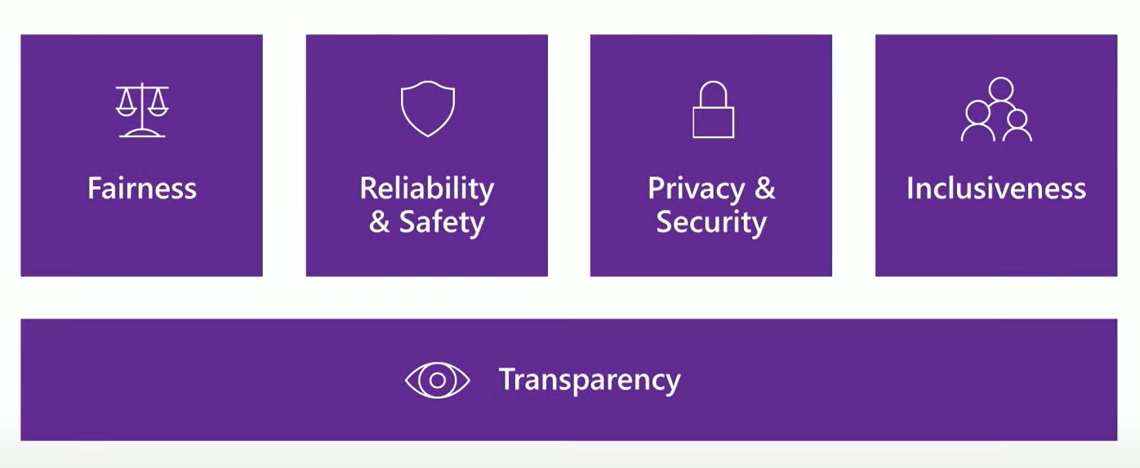
Introduction
Finding the best fit model is not the only goal.
To gain trust in AI, we need to make sense of its decisions.
Notes:
As the business, not like in academic environment, finding the best model, the state-of-the-art technique is not our only goal. We, engineers, data scientists, cannot just find the best-accuracy model without knowing how it works and then pitch to our clients and sell it. We have to provide more details to prove it will work and accuracy is just one of them. There are other factors like fairness, reliability & safety, privacy & security, and inclusiveness that we must put our attention to. And all of that are based on the foundation of transparency. What do I mean by transparency? It is the most important question of our presentation. How do you make sense of your model? When you understand it, making sense of it, you are much more confident to put it out in a real-world situation.

Slide 4

Importance of Interpretability
Safety: autonomous driving car - Uber incident.
Notes:
A self-driving Uber car that struck and killed an Arizona woman wasn't able to recognize that pedestrians jaywalk. Because the car couldn't recognize Elaine Herzberg as a pedestrian or a person — instead alternating between classifications of "vehicle, bicycle, and an other" — it couldn't correctly predict her path and concluded that it needed to brake just 1.3 seconds before it struck her as she wheeled her bicycle across the street a little before 10 p.m. So how can they fix that?

Slide 5
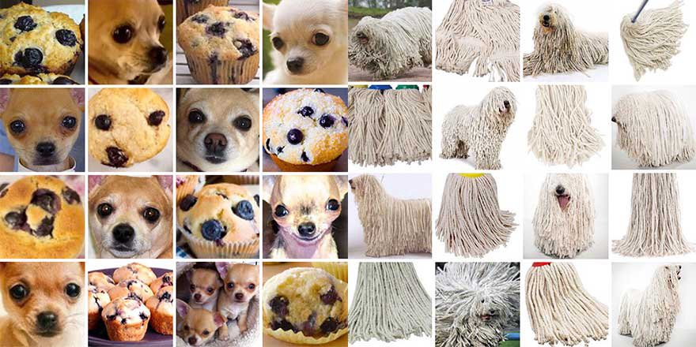
Importance of Interpretability
Debugging/Fixing
Notes:
First, they have to look at the error of misclassification. Here I am using an example of misclassifying puli dogs with sweepers and chihuahua vs muffin. We can intuitively reason why the model having a so difficult time classifying these classes. This is one step of making sense of your model – why does it behave this particular way? This is an easy example, when the case is not this easy.

Slide 6
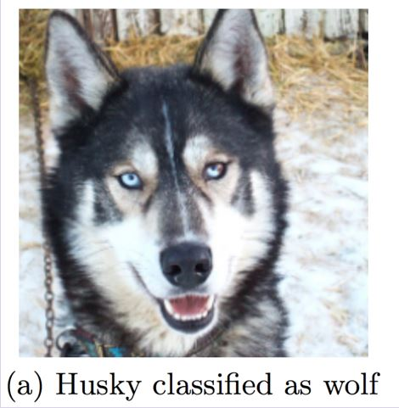
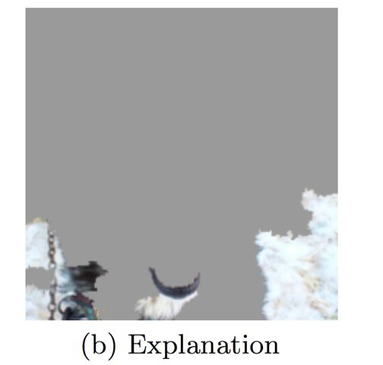
Importance of Interpretability
Mismatched objectives: what you optimize is not what you meant to optimize.
Notes:
In this example, a model is trained to classify between husky and wolf. Here is an instance of a husky classified as wolf. Using LIME, one of the state-of-the-art method for ML interpretability, we can see that this model is using snow as the main evident to conclude wolf class. When we know this, we can start wondering why this happened? Could be the preprocessing image was wrong or too many wolf with snow background? This shows how helpful model interpretability can be

Slide 7


Importance of Interpretability
Decision-focused applications: access modeling/insights, loan services (GDPR), …
Notes:
In IGA, one of the main questions to tackle is “who can access what?”. We cannot answer that question fully without the why, why I can/cannot give you access to this role? For other companies, e.g. in financial sector, compliance with GDPR – General data protection regulation was a strong motivation. A part of GDPR stated that Individuals have the right not to be subject to a decision that is based solely on automated processing. So for example, in loan services, if a bank automates its decision of whether or not to grant a loan to a certain individual, that individual should be informed of the reasoning behind the decision and given the opportunity to contest the decision and request human intervention.

Slide 8
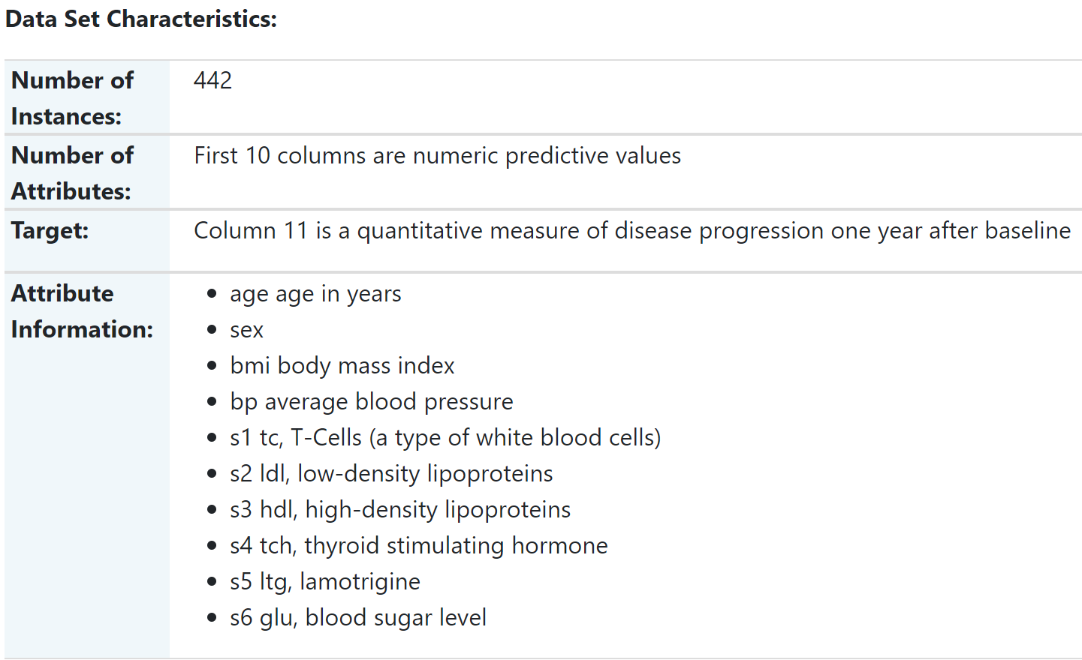
Demo Dataset
Notes:
For the rest of my presentation, most of the figures/examples are made using this diabetes dataset containing health data form 442 patients, the attributes contain age, sex, bmi, bp and 6 blood serum measurements. The target is a quantitative measure of disease progression after one year.

Slide 9
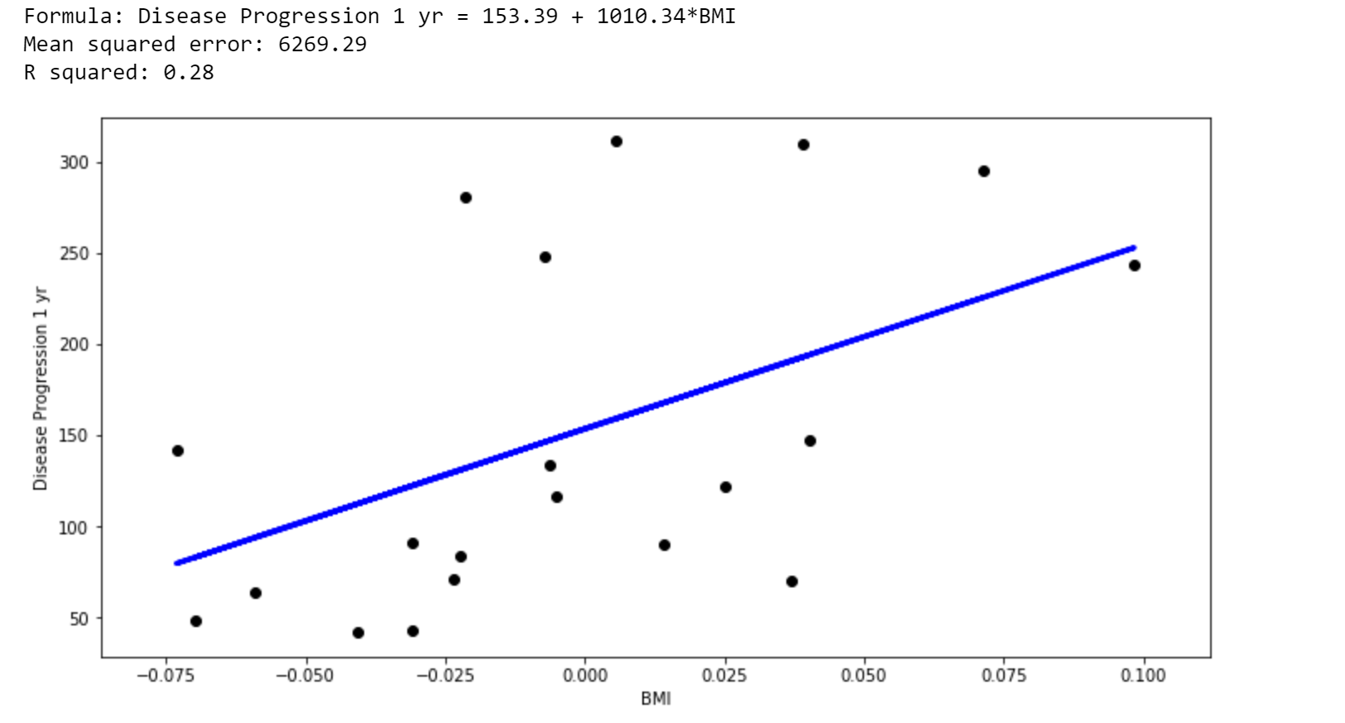
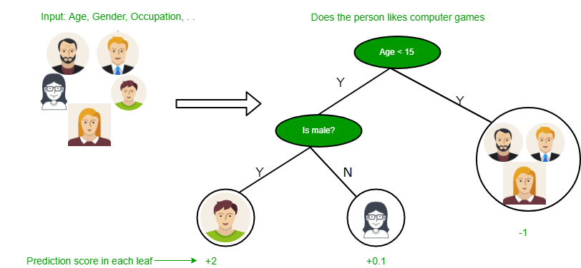
Interpretable Models
- Many more: Logistic Regression, Generalized Linear Models, Decision Rules, ruleFit, Naive Bayes,...
Decision Tree
Linear Regression
Notes:
Talking about ML interpretability, there are conventionally two subsets. One of which is interpretable models, the models that are naturally/obviously interpretable vs the models that are more involved and cannot be obviously or easily interpreted. The first one comes into my mind is decision tree. To explain it, we go from the observations about a sample (represented in the branches) to conclusions about the sample’ target ( represented in the leaves). The image is showing a task of finding who like playing computer games, we can explain the model pretty easily by going through it branches and nodes. Another representative model is linear regression, this plot is made by fitting a linear regression model on the diabetes dataset with the blood mass index as independent variable. We can explain the impact of the bmi attribute based on the weight in the LR formula.

Slide 10
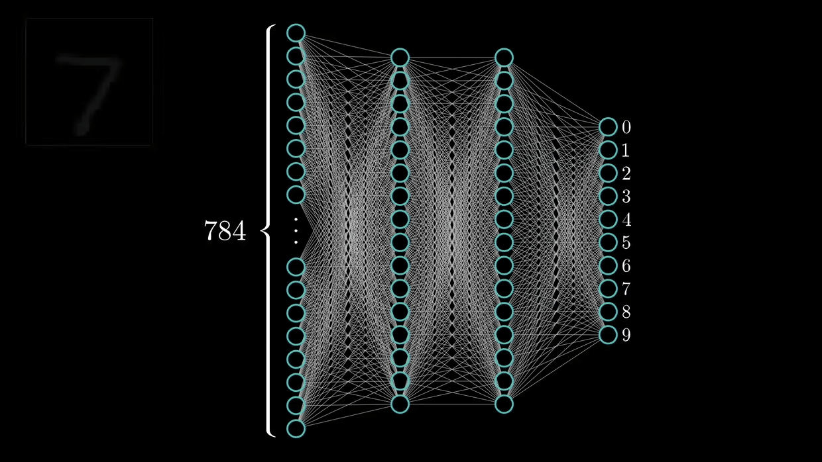
Black-box model
Neural networks: explaining the activated nodes.
Random forests, GBM, XGBoost
neurons
Notes:
There are so much more models in interpretable models. In fact, given enough time, enough resources, you can basically explain all the models by looking at the weights. But then, what is a black-box if we all know how the architecture works? For example, neural networks can be explained the following example. The model is trained to classify gray-scale hand-written images. The NN accepts the input from 28x28 pixels ~ 784 nodes and each nodes corresponds to each pixel. The non-black pixel triggered a combination of activation trained to recognize the pattern of non-black pixels -> to classify the image. Is it not that bad isn’t it? However, that is just explaining on a general model how it works, produce no insight or trust that it will actually capture the pattern of a number like 2 for instance.

Slide 11
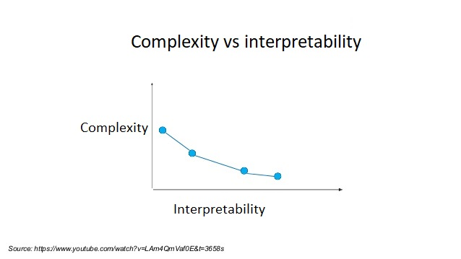
Trade-off
Notes:
I mentioned the first class is interpretable models, the second is model-agnostic methods. Which mainly contains two subclasses : global and local methods. Model-agnostic methods don’t care about which architecture you are using, linear regression, support vector machine, random forest, neural network, don’t matter. So model-agnostic are general methods that use a bunch of approximations depending on what model you are using. This is super duper helpful because now you are able to train a very strong/state-of-the-art predictor model then uses an external model to explain the reasoning. For today, we will first talk about global vs local interpretation, then LIME and SHAP

Slide 12
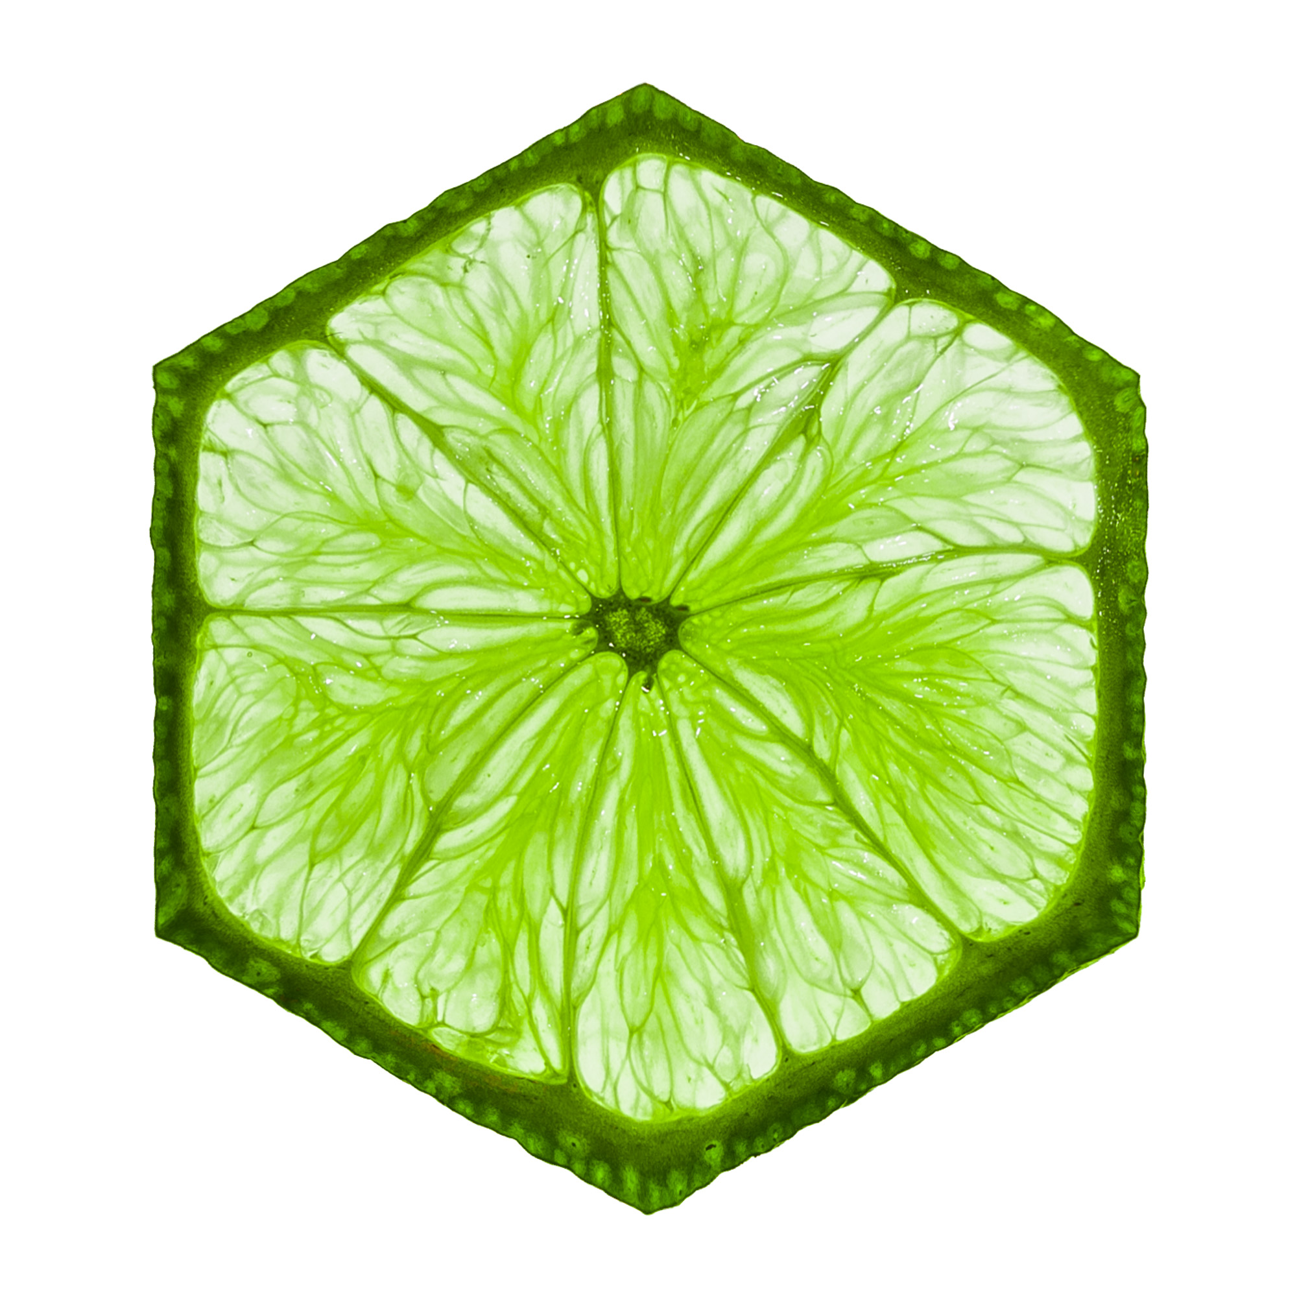
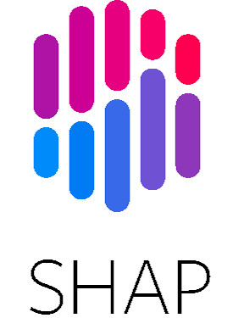
Model-Agnostic Methods
Global vs Local
LIME - Local Interpretable Model-Agnostic Explanations
SHAP - SHapley Additive exPlanations
LIME
Notes:
I mentioned the first subset is interpretable models, the second is model-agnostic methods. Which mainly contains two subclasses : global and local methods. Model-agnostic methods don’t care about which architecture you are using, linear regression, support vector machine, random forest, neural network, don’t matter. So model-agnostic are general methods that use a bunch of approximations depending on what model you are using. This is super duper helpful because now you are able to train a very strong/state-of-the-art predictor model then uses an external model to explain the reasoning. For today, we will first talk about global vs local interpretation, then LIME and SHAP

Slide 13
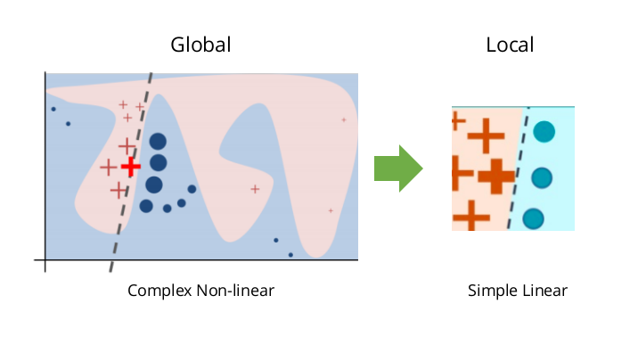
1. Global vs Local
Global interpretation: looking at the general landscape of features/attributes.
Local interpretation: looking at the landscape of a particular instance or a small set of instances.
Notes:
Looking at the global graph, we can see that there are two regions colored with red and blue representing two classes of a classification problem. Global interpretation is looking at the global view of the landscape of the features affecting the outcomes. For local interpretation, it explains why the model predict particularly for an instance. For example, in the right figure, the line, at those instance, we can approximately separate two regions by a straight line but it may not agree/apply to every instance.

Slide 14
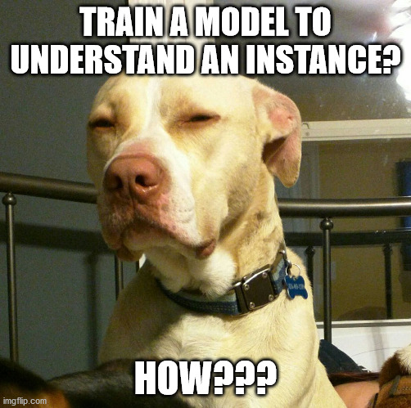
2. LIME - Local Interpretable Model-Agnostic Explanations
LIME is a local interpretation method that use a surrogate/interpretable model to help to understand the prediction of the black-box.
Intuition: it is easier to understand the black-box locally as opposed to trying to approximate a model globally.
Notes:
LIME - Local Interpretable Model-Agnostic Explanations, a very long name, basically, it is a local interpretable method that uses a simple (linear)/interpretable model to explain the prediction of a blackbox at 1 particular instance. The simple model is called the surrogate model, which can be linear, logistic regression. So the intuition is that, use an interpretable model to understand the blackbox locally is much easier than trying to approximate it globally.

Slide 15
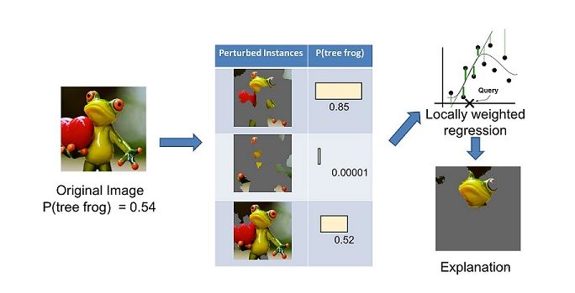
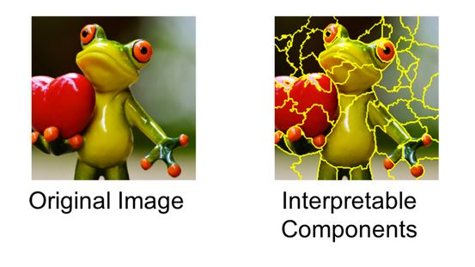
2. LIME - Local Interpretable Model-Agnostic Explanations
Separate into interpretable components.
Generate a data set of perturbed instances.
Feed perturbed instances and get score.
Learn a weighted model.
Find the highest positive weights (interpretable components) as the explanation.
Notes:
Imagine we want to explain a classifier that predicts how likely it is for the image to contain a tree frog. We take the image on the left and divide it into interpretable components, this can be done for any types of data. For this image, it can be done randomly or based on the shape of the object, for tabular dataset, the interpretable components are the features, for nlp, they are the separated words. Then, we generate a data set of perturbed instances by turning some of the interpretable components “off” (in this case, making them gray). For each perturbed instance, we get the probability that a tree frog is in the image according to the model. We then learn a simple (linear) model on this data set, which is locally weighted—that is, we care more about making mistakes in perturbed instances that are more similar to the original image. In the end, we present the components with highest positive weights as an explanation, graying out everything else.

Slide 16
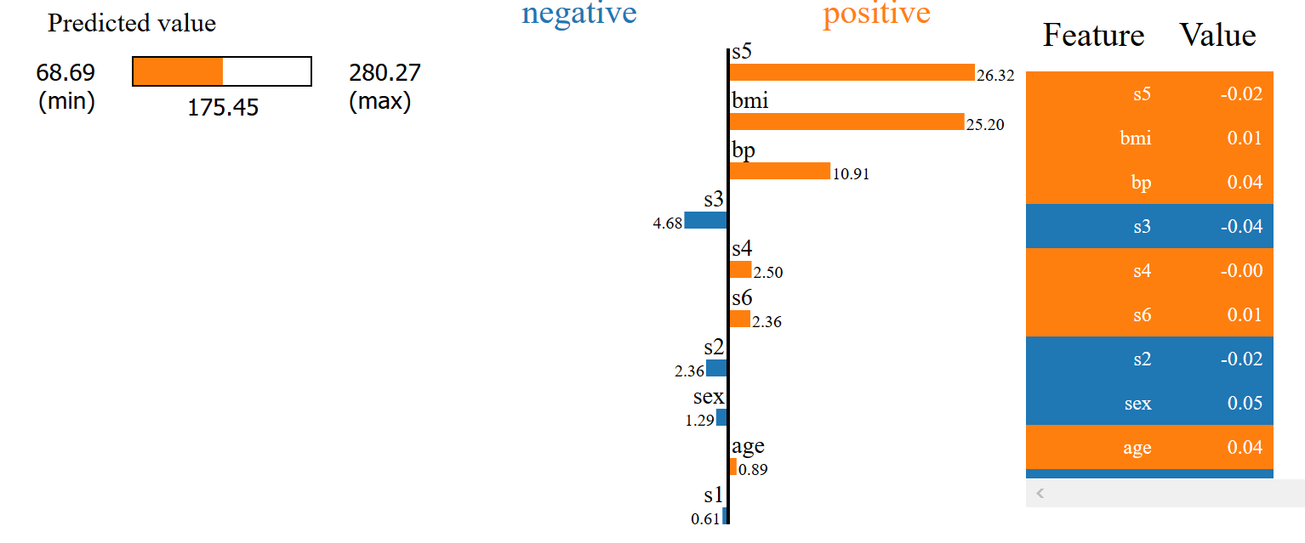
2. LIME - Local Interpretable Model-Agnostic Explanations
Our prediction: 161.77
True target: 127
Left part: statistics on the target distribution
Middle part: relative feature importance (from the weighted model)
Right part: feature value of this instance
Notes:
Now, we look at an example of applying LIME for an instance of the diabetes dataset. Our prediction is quite far off the true target, but it is still common because it is a regression problem. The plot generated by LIME has 3 parts, left one is…, middle one iss with distinguished color codes for positive/negative impact. The right side is the feature value for this instance (normalized). So for this particular instance, we can look at the impact of the feature, understand how the black-box model uses the features for the outcome.

Slide 17
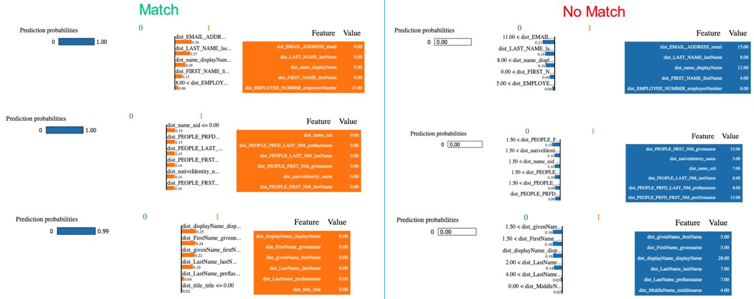
2. LIME – Applications with Sailpoint dataset
Dataset: matching identity with account.
Features: “distance” between the string attributes (first name in the identity vs first name in the account)
Notes:
For Sailpoint, the DS team has applied LIME into a task of matching the identities with accounts. The features are the similarity/distance between attributes of account/identity. In short, if we consider the email in identity and in the account, how similar are they. The edit/levenstein distance measures that, so a 0.0 distance is a perfect match. The LIME output plot perfectly explains the reasoning between match/no match classes.

Slide 18
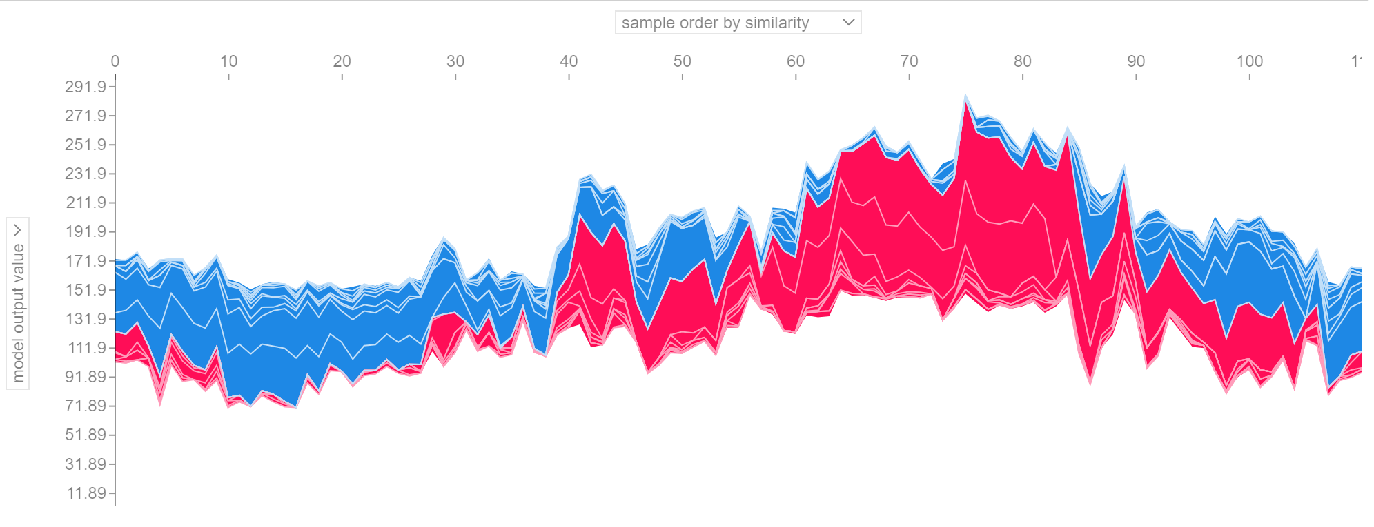
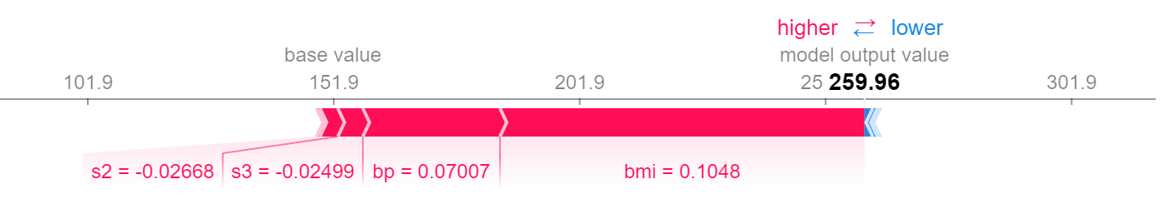
3. SHAP - SHapley Additive exPlanations
Shapley values calculate the importance of a feature by comparing what a model predicts with and without the feature. However, since the order in which a model sees features can affect its predictions, this is done in every possible order, so that the features are fairly compared.
Notes:
SHAP is a method based on a concept of Shapley value in game theory. It does a bunch of mathematical computations to figure out the contribution of features (as the players) to the outcome of the prediction (or the payout in game theory context). An intuitive way to understand the Shapley value is the following illustration: The feature values enter a room in random order. All feature values in the room participate in the game (= contribute to the prediction). The Shapley value of a feature value is the average change in the prediction that the coalition already in the room receives when the feature value joins them. This allows us to decompose a prediction in a graph like this, like LIME, SHAP also has the color code for positive/negative impact for each instance. When you find all of these shapley value, then SHAP package can output this interactive plot which shows the spectrum of contribution of each feature for each index. I will show that you can interact with the plot in the demo

Slide 19
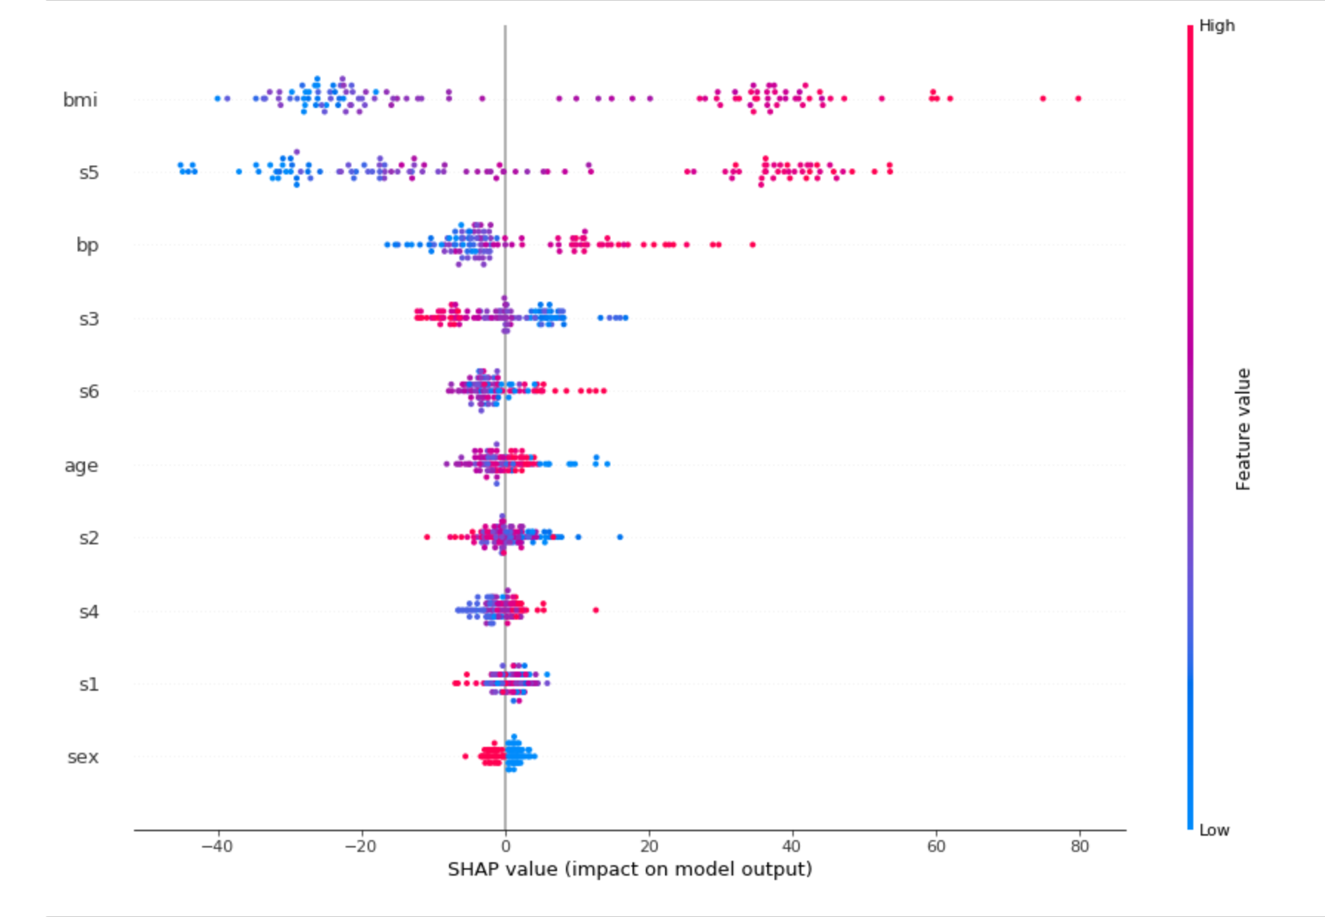
3. SHAP - SHapley Additive exPlanations
Notes:
To get an overview of which features are most important for a model we can plot the SHAP values of every feature for every sample. The plot below sorts features by the sum of SHAP value magnitudes over all samples, and uses SHAP values to show the distribution of the impacts each feature has on the model output. The color represents the feature value (red high, blue low). Each graphs give you a different perspective on the contribution.

Slide 20
Demo

Slide 21

Choosing the right tools
APPLICATION
AUDIENCE
Notes:
So here is an important question. How to choose, when to use, are they reliable? What is your audience? The answers are situational. For quality, given any dataset, SHAP is the way to go if you have enough computational power or time, Shapley values consider all possible predictions for an instance using all possible combinations of inputs. Because of this exhaustive approach, SHAP can guarantee properties like consistency and local accuracy. While LIME only use a particular perturbed set (not all combinations). In SHAP paper which was published in NeurIPS, one of the highly regarded conferences for ML, the authors show LIME is actually a subset of SHAP but lacks the consistency by using a surrogate model. So why we even need LIME? It is fast, really fast comparing to SHAP. So most of the time, for bigger dataset when computing shapley value is too costly, LIME is the way to go. Also, for not so complex dataset, LIME works just fine.

Slide 22
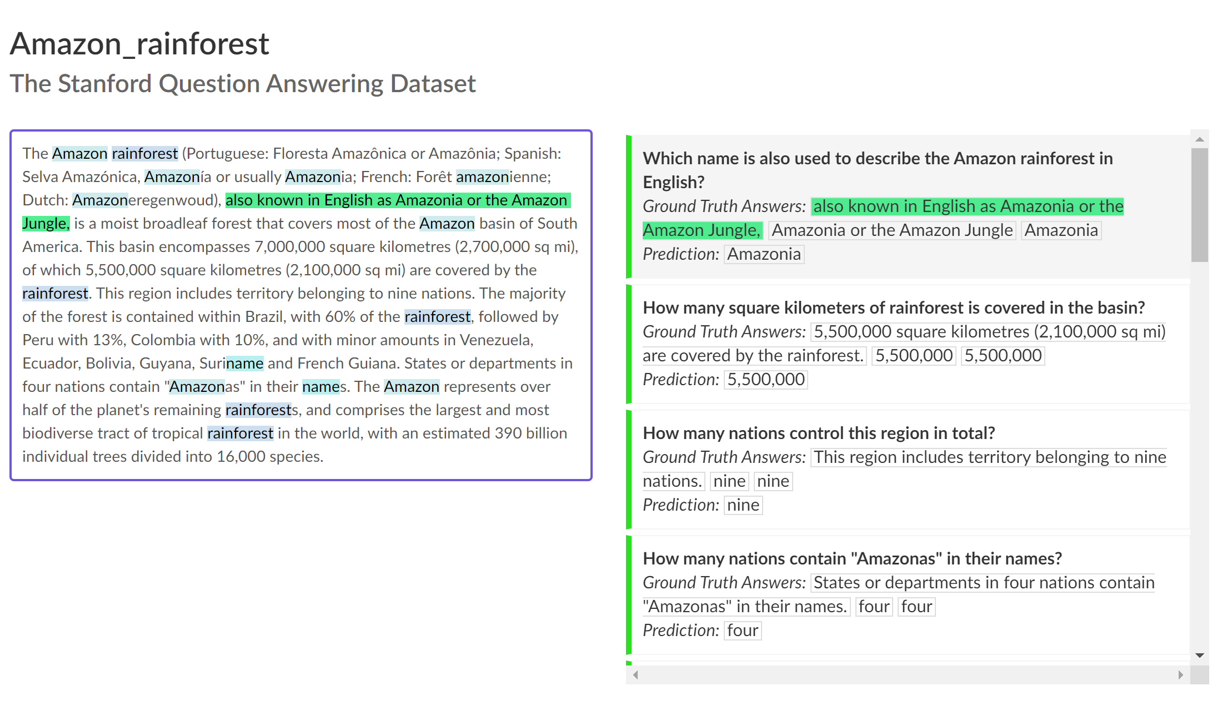
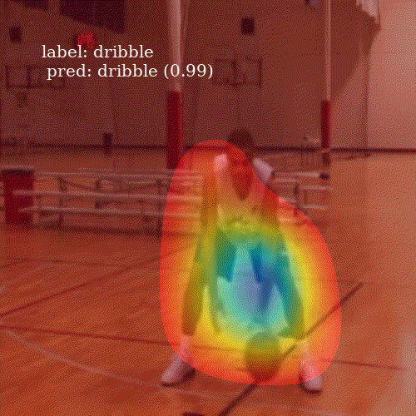
Advancement
- Attention heat map in activity detection
- Explainable NLP
Notes:
So there are other advancement in making neural networks interpretable without using third-party library. For example, natural language processing, especially the task of question answering, are generally difficult to understand. Given a question, are you sure that your trained model knows the context of the paragraph of just finding the trick to answer all the question, choosing the most frequent words, for example. SquAD provided the dataset with labeled reasoning for each answers help bring more quality to the model trained on this dataset. Other advancement was using Attention – a neuroscience-inspired mathematical concept of architecture of neural network, by looking at the attention weights, you can see how much each attribute contributes to the outcomes.

Slide 23
Q&A

Slide 24
REFERENCES
PDP:
Paper: Friedman et al. “Greedy function approximation: a gradient boosting machine.”
Tools: PDPbox, sklearn.
ICE:
Paper: Goldstein et al. “Peeking Inside the Black Box: Visualizing Statistical Learning with Plots of Individual Conditional Expectation.”
Tools: PyCEbox
PFI:
Paper: "Breiman et al.“Random Forests.”
Tools: sklearn.
LIME:
Paper:
Ribeiro et al. "Why should I trust you?: Explaining the predictions of any classifier."
Ribeiro et al. “Local Interpretable Model-Agnostic Explanations (LIME): An Introduction”
Tools: LIME
SHAP:
Original paper: Lundberg et al. "A unified approach to interpreting model predictions."
Faster implementation for tree models: https://arxiv.org/abs/1802.03888
Tools: SHAP
Other sources:
https://www.twosigma.com/insights/article/interpretability-methods-in-machine-learning-a-brief-survey/
Molnar, Christoph. "Interpretable machine learning. A Guide for Making Black Box Models Explainable", 2019.
Friedman, Jerome, Trevor Hastie, and Robert Tibshirani. “The Elements of Statistical Learning”.
Zhao, Qingyuan, and Trevor Hastie. “Causal interpretations of black-box models.”
Riccardo Guidotti, Anna Monreale, Salvatore Ruggieri, Franco Turini, Dino Pedreschi, Fosca Giannotti. “A Survey Of Methods For Explaining Black Box Models”.

